Slide 1
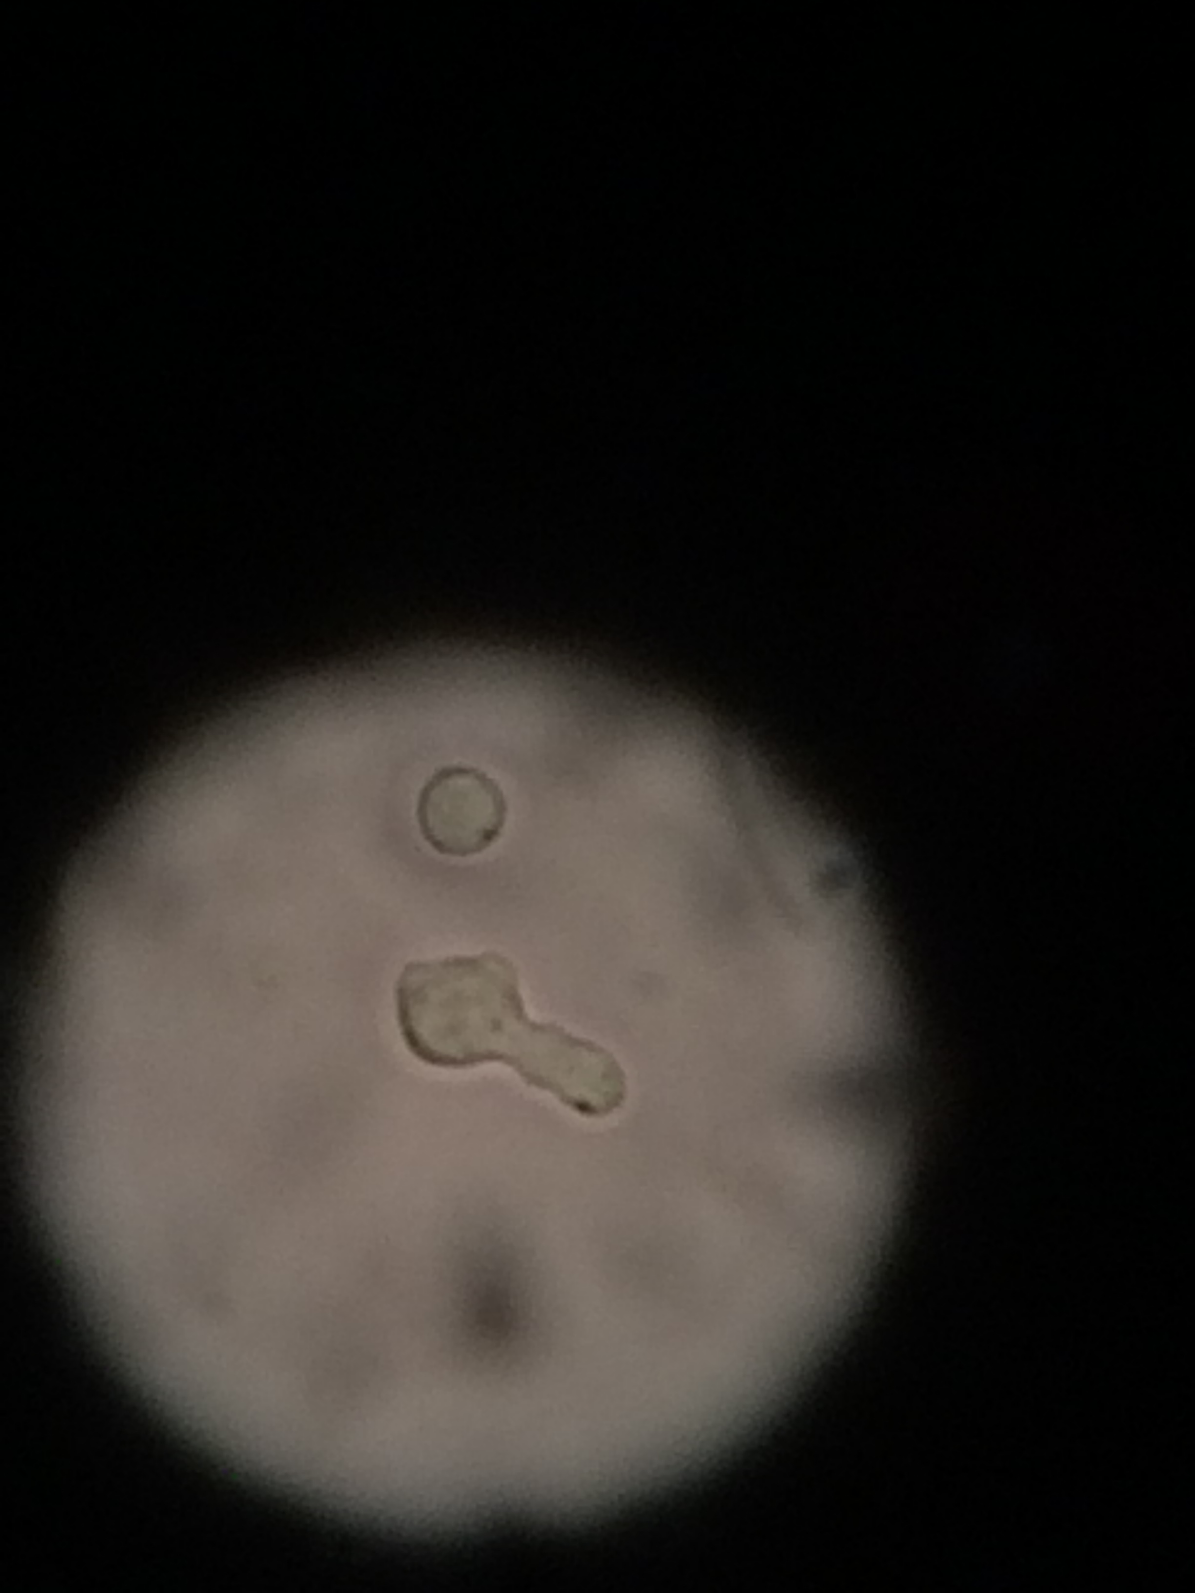
Characterizing TCR γ𝛅 T cells in tissues and disease
Toufic Mayassi
University of Chicago
Jabri Lab
ICDS 2015

Slide 2
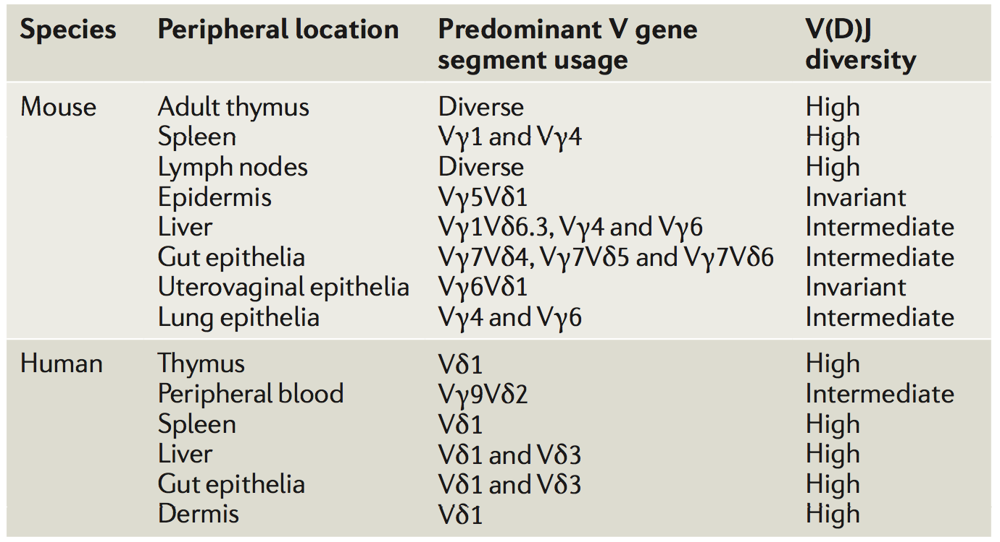
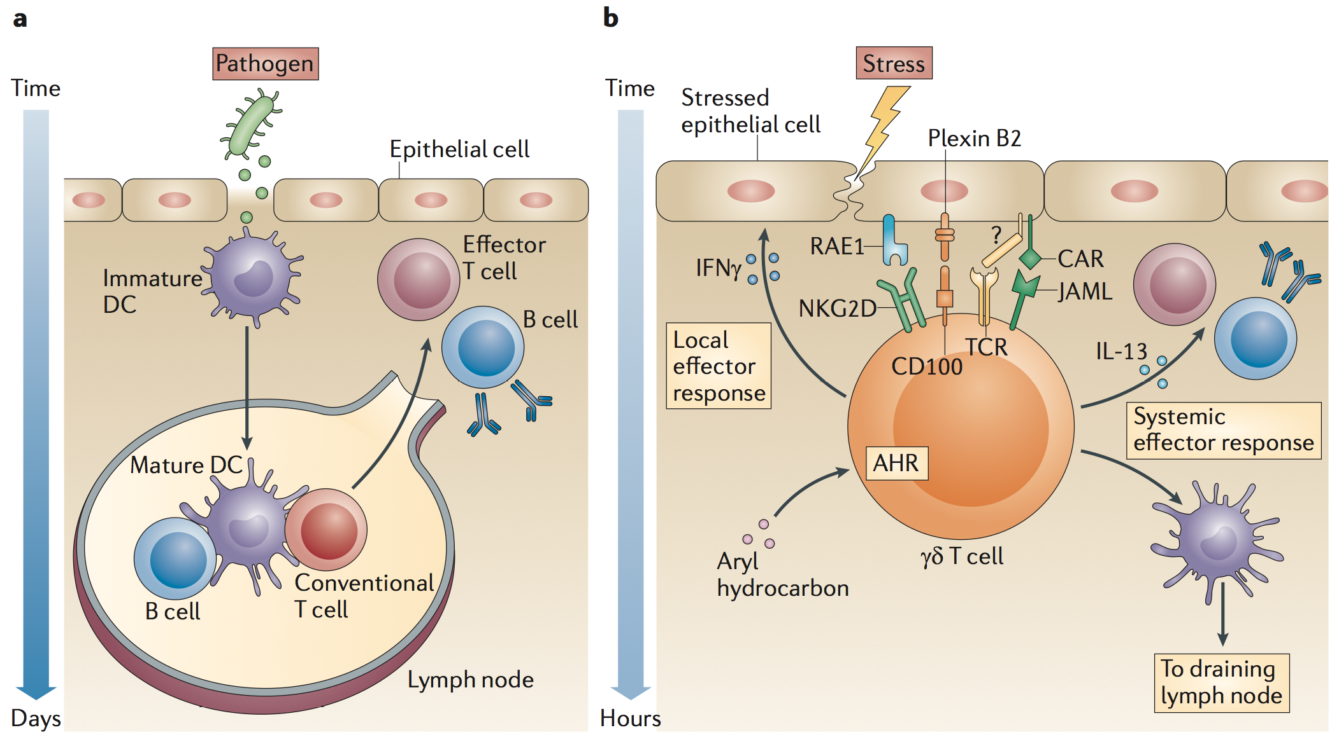
Nature of TCR recognition
Tissue distribution
First line of defense
Luoma, A et al. Immunity 2013.
Uldrich, P et al. Nat Immunol. 2013.
Bonneville, M et al. Nature Rev. Imm. 2010.
Vantourout, P and Hayday, A. Nature Rev. Immun. 2013.

Slide 3
Goal of the study
In this study we will investigate the hypothesis that the small intestinal microenvironment uniquely selects the TCR repertoire and shapes the transcriptional profile and epigenetic landscape of TCR γδ T cells under physiological and pathological conditions, thus giving us insight into the general biology of of TCR γδ T cells as well as allowing us to better understand the role of TCR γδ T cells in celiac disease.
TCR
Disease
Tissue

Slide 4
Approach
TCR- Delta Chain
VD1
DN
VD2
Disease
Control
Gluten Free CD
Active CD
Tissue
Blood
Intestine

Slide 5
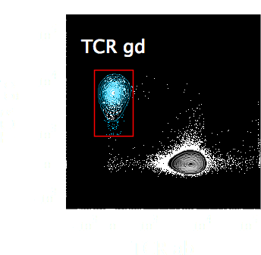
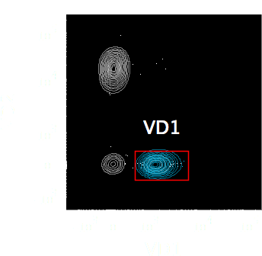
Frequency of TCR γδ T cells across tissue and disease
Vδ1 bearing T cells are not overrepresented in CD
Blood
Intestine
Halstensen, T et al. Scan. J. Immunol. 1989.
Unpublished data
Notes:
Given this lack of VD1 selection we next thought to look at the gamma chain which nobody has ever done
The expansion is not VD1 specific
She wants me to add a slide like Reinhards here with the see through shit

Slide 6
TCR sequencing reveals a shift in gamma chain usage in Vδ1 T cells
Subject #1
Subject #2
Subject #3
Subject #4
Vg2
Control
Vg3
Vg4
Active CD
Small Intestine
Vg5
Vg8
Gluten Free CD
Vg9
Small Intestine
Subject #1
Subject #2
Subject #3
Subject #4
Vg10
Control
In collaboration with
David Price
Kristin Ladell
James McLaren
Active CD
Blood
Gluten Free CD
Unpublished data
Notes:
Talk about the age and how the GFD is the oldest one that has the shift

Slide 7
Conclusion
Vδ1 bearing T cells are not overrepresented in the expansion of TCR γδ T cells found in CD.
Vδ1 T cells bearing the Vγ4 chain are selected in the small intestine of controls suggesting homeostasis in the small intestine is driven by a ligand that involves recognition by Vγ4.
The shift in gamma chain usage and low diversity in active CD suggests that the gamma chain may be implicated in recognition of a CD-associated ligand.
The increase in diversity at the level of the gamma chain in GFD patients with some restoration of the Vγ4 subset suggests a CD associated dynamic turnover in Vδ1 T cell subsets.
These data suggest the gamma chain may play a critical role in TCR γδ recognition in the small intestine.
Luoma, A et al. Immunity 2013.
Uldrich, P et al. Nat Immunol. 2013.

Slide 8
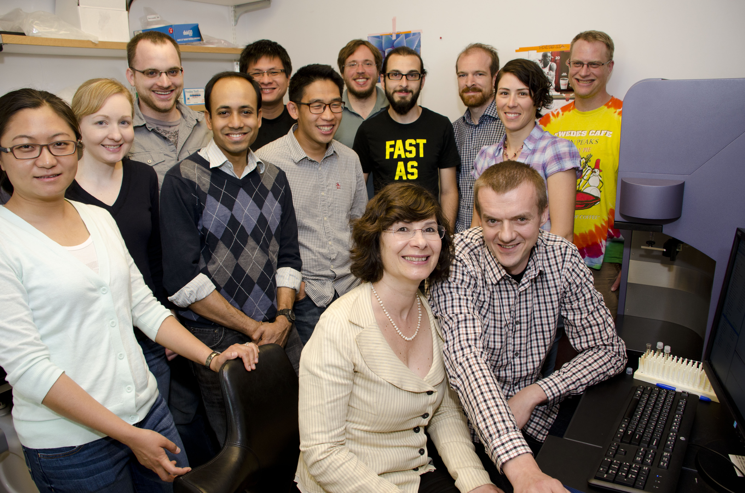

Acknowledgments
Jabri Lab
Bana Jabri
Cezary Ciszewski
Kathryn Lesko
R01 DK067180
Immunology Training Grant
Physicians
Stefano Guandalini
Sonia Kupfer
Carol Semrad
!
!
Price Lab
David Price
Kristin Ladell
James McLaren
Koning Lab
Fritz Koning
Vincent Van Unen
Wijmenga Lab
Cisca Wijmenga
Raul Gamboa
Yang Li
Sebo Withoff
Barreiro Lab
Luis Barreiro
!
!
!

